Slide 1
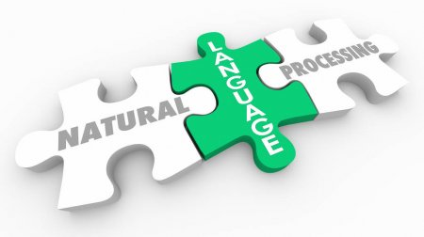
Reverse Mad Libs
Natural Language Processing
Scott Bing

Slide 2
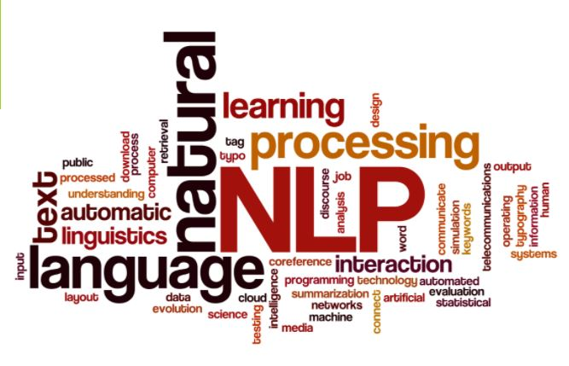
Reverse Mad Libs
Natural Language Processing
Scott Bing

Slide 3
Agenda
Introduction
What is Natural Language Processing
A Brief History of NLP
My Project: Reverse Mad Libs Game
Resources used
Questions

Slide 4
What is Reverse Mad Libs?
A twist on the popular game
Player one is asked for a list of arbitrary words
Player two inserts the words into a story
Player one typically does not see the story until the words are filled in
Machine uses NLP Algorithms to predict the missing words

Slide 5

Project Resources
Python – primary implementation Language
Pytorch - Python package for Data Science
Bert – Python NLP Package developed by Google
Tkinter – PythonPackage for GUI development

Slide 6
Natural Language Processing
An attempt to meld human language with computer language.
Teach a computer how to converse with a human
Recognize human language
Computer converse with human

Slide 7
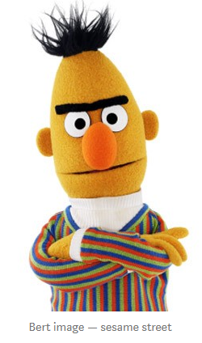
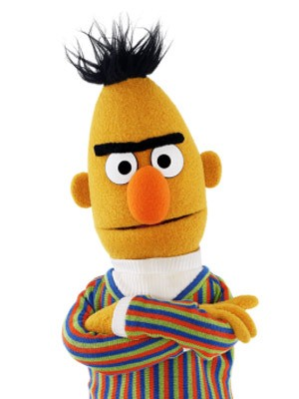
Not this Bert
https://medium.com/@noa.kel/using-bert-with-pytorch-b9624edcda4e

Slide 8
Bert (Bidirectional Encoder Representations from Transformers)
Bi-directional processing
Transformer

Slide 9
What is BERT?

Slide 10
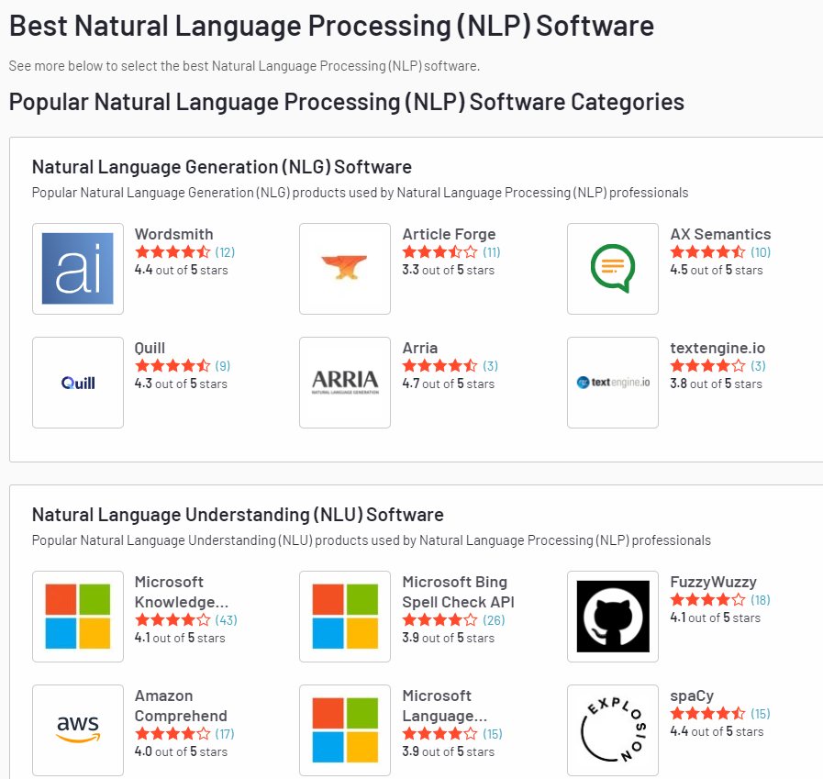
Other NLP Resources
https://www.g2.com/categories/natural-language-processing-nlp

Slide 11

Why did I choose Bert
Ease of installation and use
Unique Parsing Facility
Works well with Python

